Slide 1
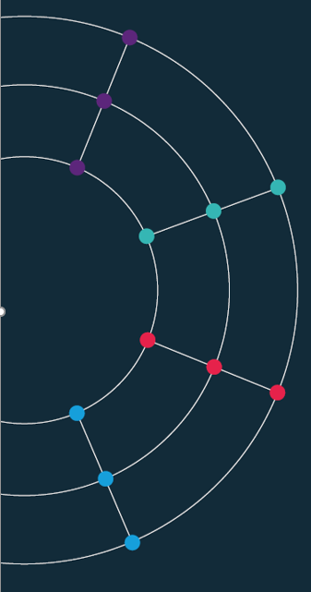
Self-guided learning. Building tools to learn from the data
[90 min]

Slide 2
Self-guided learning. Building tools to learn from the data
Cartography
[90 min]
[30 min]

Slide 3
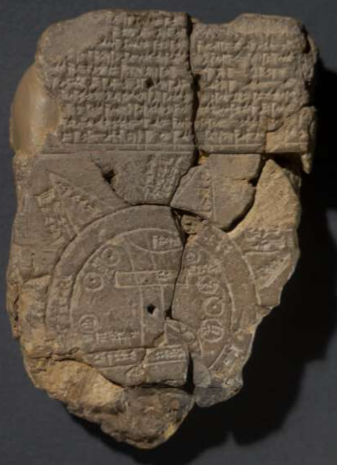
Cartography.
A potted history
600 BC. Babylonian World Map.
801. Tang Dynasty. Hainei Huayi Tu (海内華夷圖)
Map of Chinese and non-Chinese Territories in the World
1527. Diogo Ribeiro (Portuguese), the Pádron Real.
1569. Gerardus Mercator (Flemish). World Map.
In this course we are not interested in maps on their own. Rather we want to plot economic and social data on maps. This is known, historically, as social cartography.
The historical focus has been social concerns: illness, poverty, and deprivation.

Slide 4
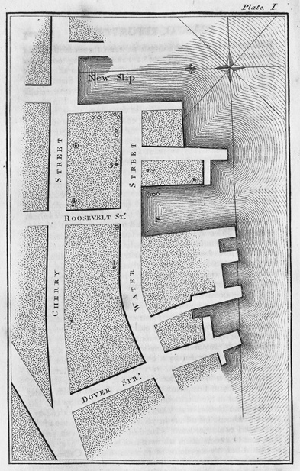
Valentine Seaman- Yellow Fever
Dr Valentine Seaman (1796). An Inquiry into the Cause of the Prevalence of the Yellow Fever in New-York
The first example of plotting illness on a map.
1795 yellow fever epidemic.
Cause of the spread was unknown – was it ships from tropics?
[It is spread by mosquitos]
Seaman mapped ships and waste sites, along with cases of the disease.
Cutting edge study (but did not correctly identify mosquitos as the carrier).

Slide 5
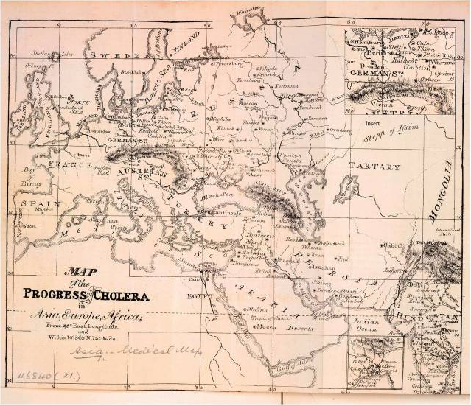
Global Health - Cholera
The Lancet (1831).
Maps were used in the first example of global health analytics.
This one plots towns and cities known to have cholera outbreaks.

Slide 6
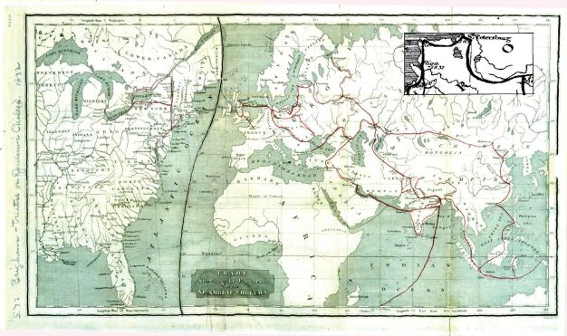
Amariah Brigham - Cholera
Amariah Brigham (1831). A Treatise on Epidemic Cholera
Theme emerging: early map makers are trying to establish causality
The hypothesis: a link between human travel and disease.
The finding: trade and illness followed the same routes across continents.
[Cholera is a bacterial infection, and transmitted through food or water contaminated with human waste]

Slide 7
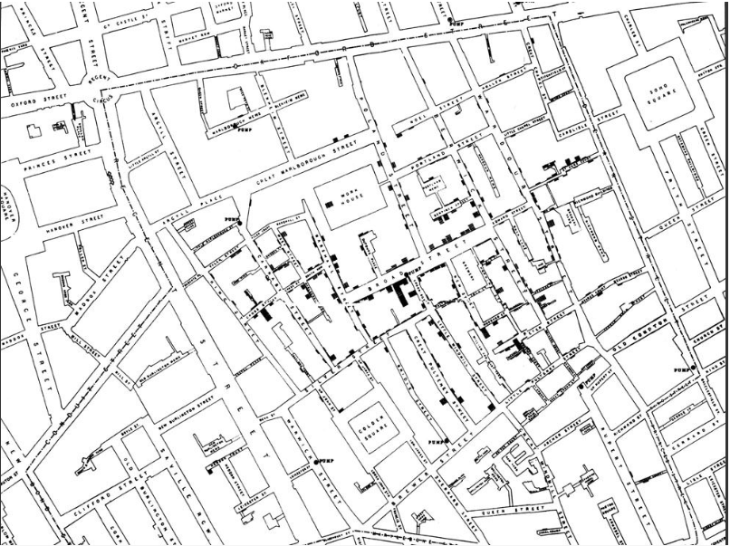
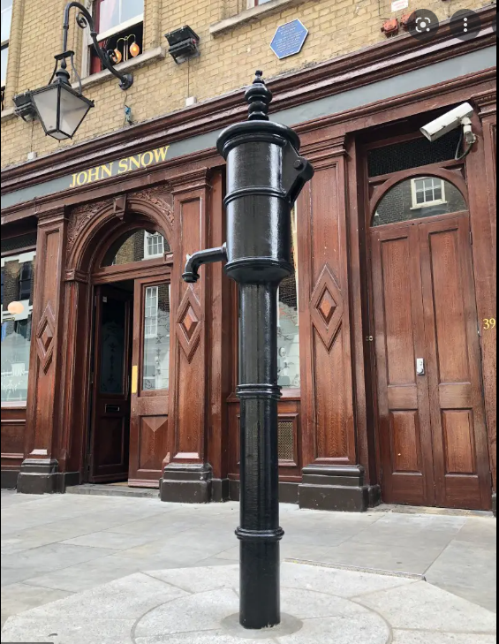
John Snow - Cholera
Dr. John Snow, father of epidemiology, 1854.
https://www.theguardian.com/news/datablog/interactive/2013/mar/15/cholera-map-john-snow-recreated

Slide 8
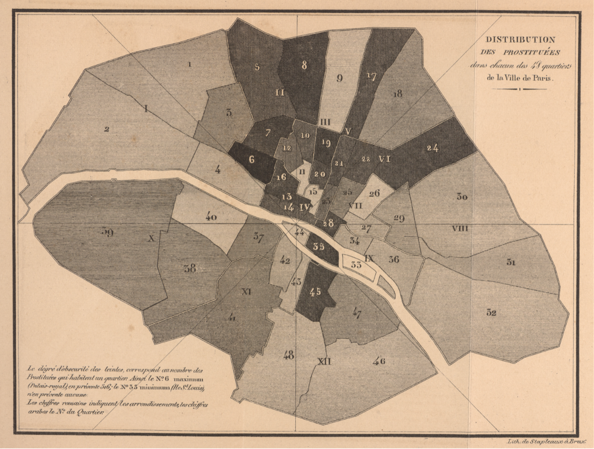
Parent du Châtelet - Prostitution
Distribution des Prostituees dans chacun des 48 quartiers de la Ville de Paris
https://digital.library.cornell.edu/catalog/ss:3293767

Slide 9
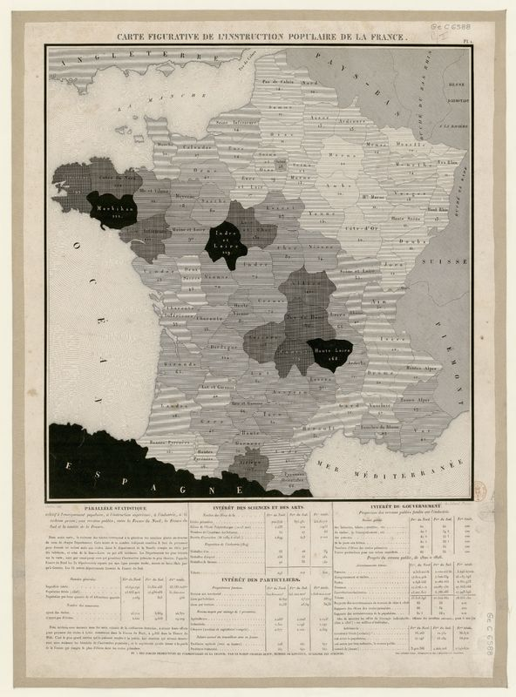
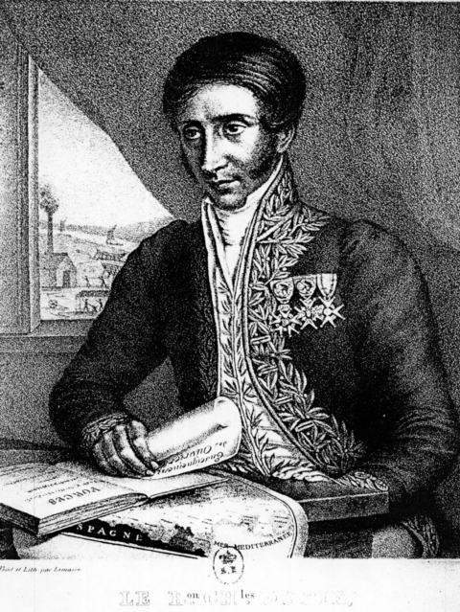
Pierre Charles Dupin
The emergence of tinted maps (1827)
Choropleth map:
A term from 1938 (geographer John Kirtland Wright)
From Greek: choros 'area/region', plethos 'multitude’.
Earliest versions had simpler name: cartes teintées.
To make visible the main difference, I had the idea to give to the various départements shades all the more dark since they sent less pupils to schools. Dupin (1827)
What explains low literacy rates?

Slide 10
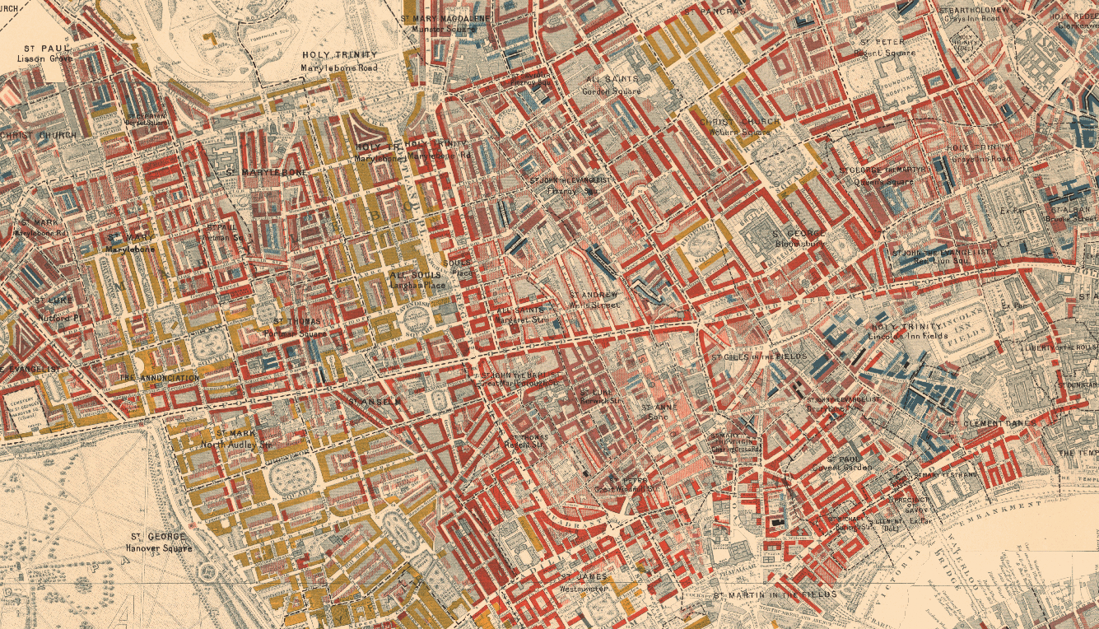
Charles Booth – Poverty
Inquiry into the Life and Labour of the People in London
Vital historical survey
Undertaken between 1886 and 1903
Examined working class life C19th
Notes and data have survived
A milestone in development of the methodology of social investigation in the United Kingdom.
https://booth.lse.ac.uk/map/14/-0.1203/51.5212/100/0
Notes:
Lowest class. Vicious, semi-criminal. Black
Very poor, casual. Chronic want. Dark blue
Poor. 18s. to 21s. a week for a moderate family. Light blue Mixed.
Some comfortable others poor. Purple
Fairly comfortable. Good ordinary earnings. Pink
Middle class. Well-to-do. Red
Upper-middle and upper classes. Wealthy. Yellow

Slide 11
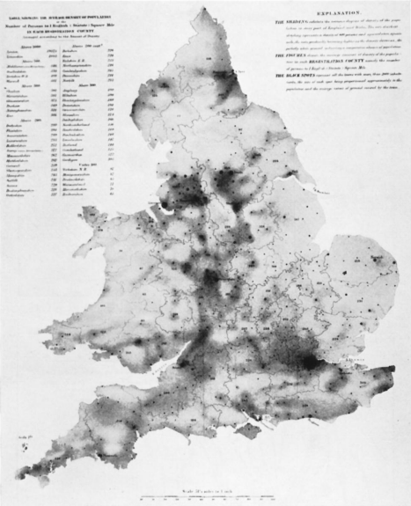
Augustus Petermann – Population
Mapping Census data (1852)
Petermann was a German geographer
Worked in the UK – producing population maps (inc on Cholera)
This map based on Census data.
Modern incarnation, the latest ONS mapping tool:
ONS Census Maps
Gilbert (1958) “Pioneer Maps” - https://www.jstor.org/stable/pdf/1790244.pdf

Slide 12
Maps today.

Slide 13
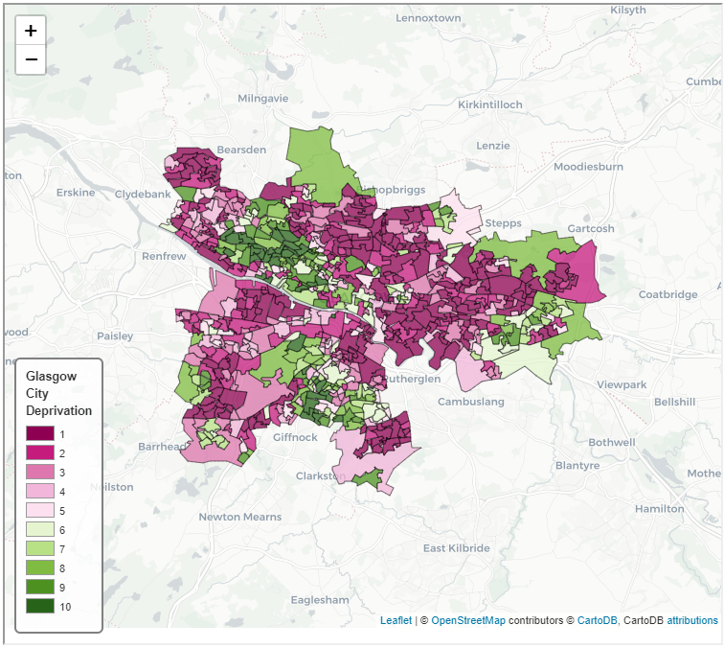
Glasgow – Deprivation
Population Health in Glasgow
https://datamap-scotland.co.uk/2021/01/glasgow-deprivation-map/

Slide 14
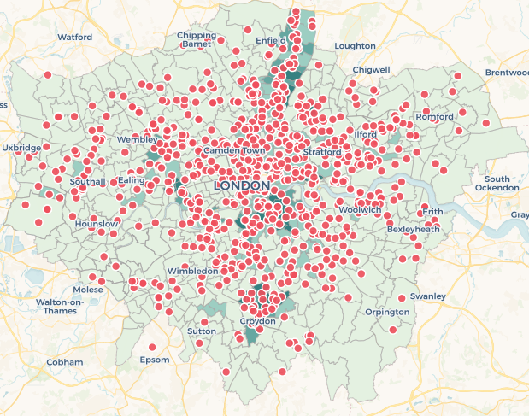
London – Crime
Tom Kirchmaier’s work with the Police
https://sites.google.com/site/tomkirchmaier/links-data

Slide 15
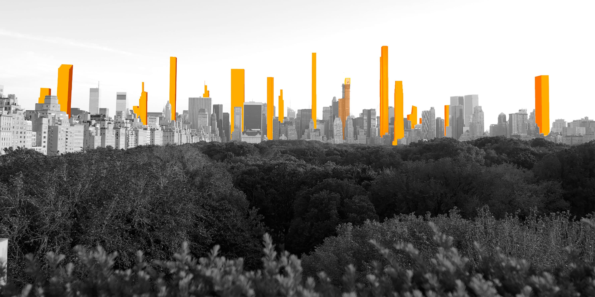
Manhattan – Shadows
The rise of super tall building and the problem of predicting shadows
https://www.mas.org/interactive_features/accidental-skyline-shadows/

Slide 16
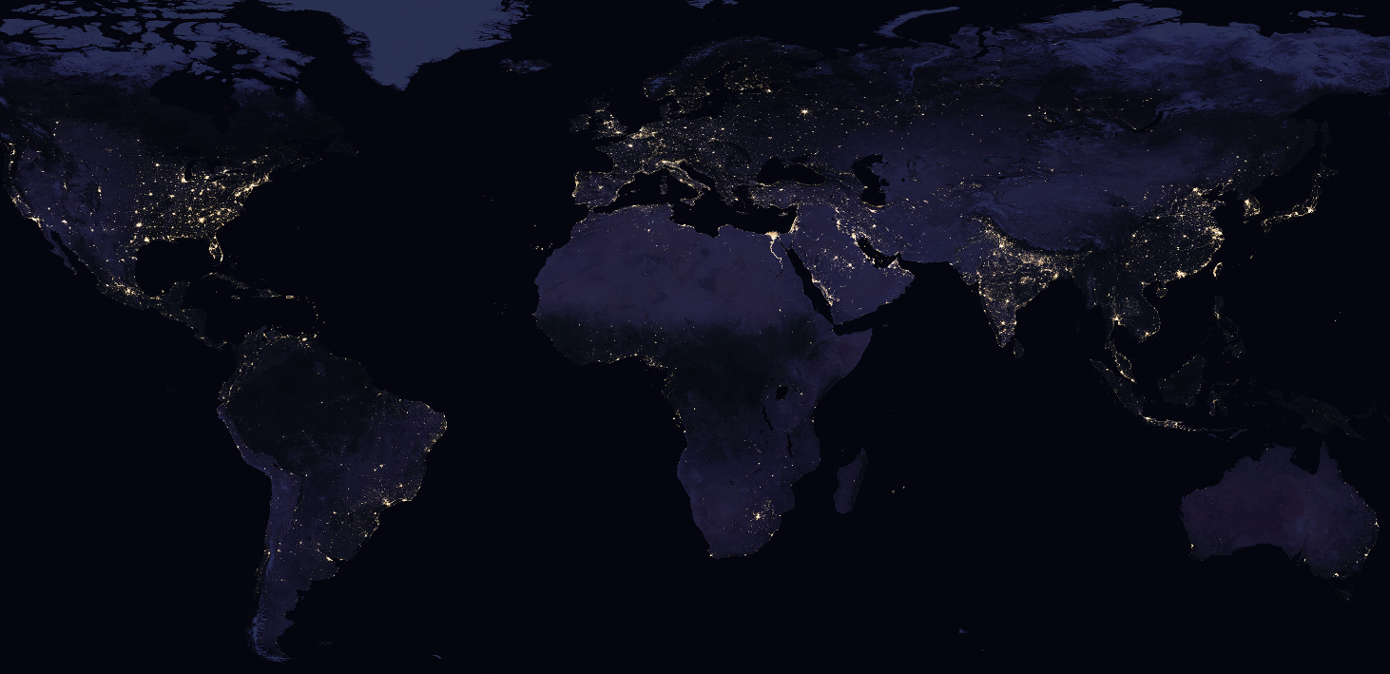
NASA – The Earth at Night
https://earthobservatory.nasa.gov/features/NightLights/page3.php

Slide 17
Terminology.

Slide 18
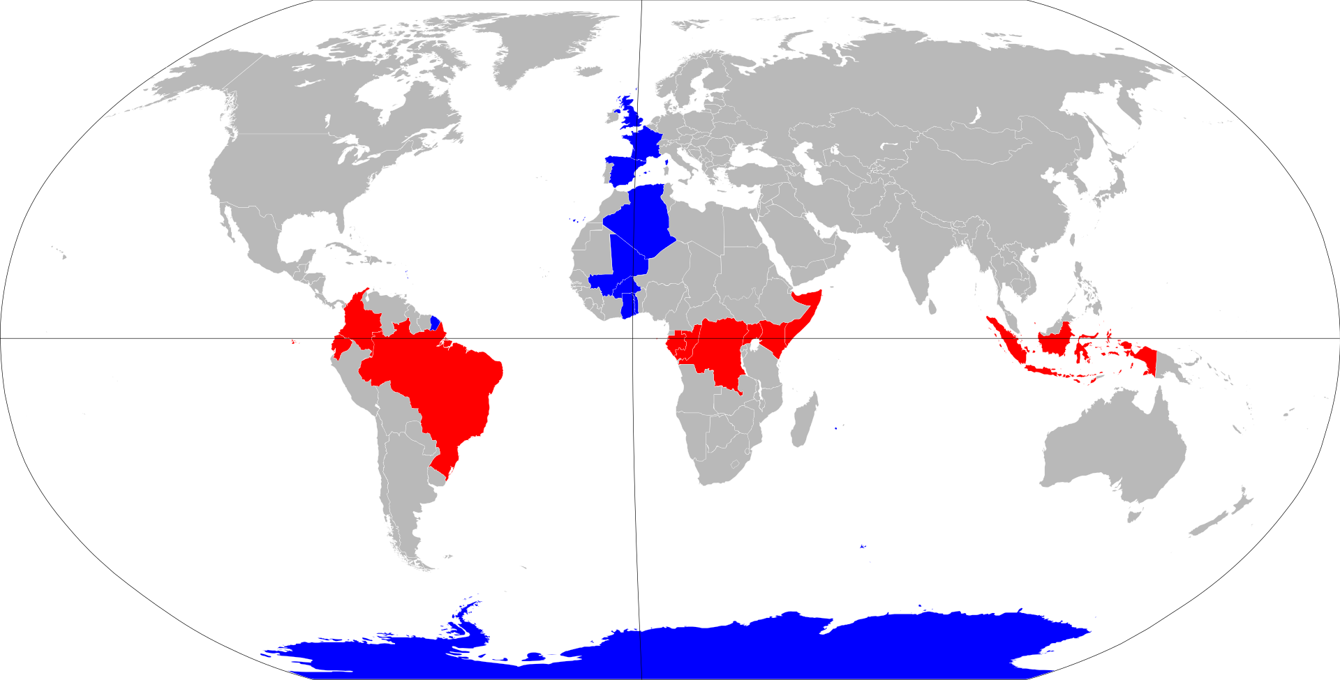
Key terms.
Some of the key terms that you will see when building your own maps
Longitude
Appear as vertical lines. Measured from Prime Meridian in degrees.
IERS Reference Meridian (close to Greenwich Meridian), used in Global Positioning System (GPS).
0° at the Prime Meridian, from +180° Eastward to – 180° Westward.
Latitude
Appear as horizontal lines. Measured as degrees.
-90° at North Pole, 0° at the Equator, +90° at the South Pole.

Slide 19
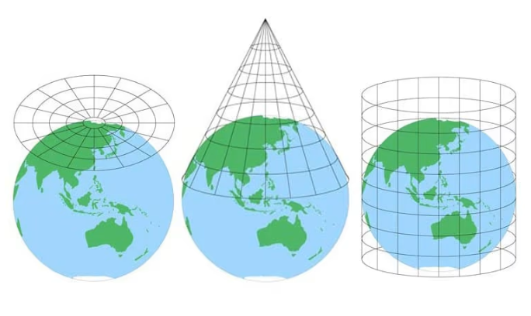
Projections.
Turning a sphere into a flat surface
Types of projection – examples:
Azimuthal Equidistant
Conic
Cylindrical
https://blog.mapchart.net/misc/quick-guide-to-map-projections/

Slide 20
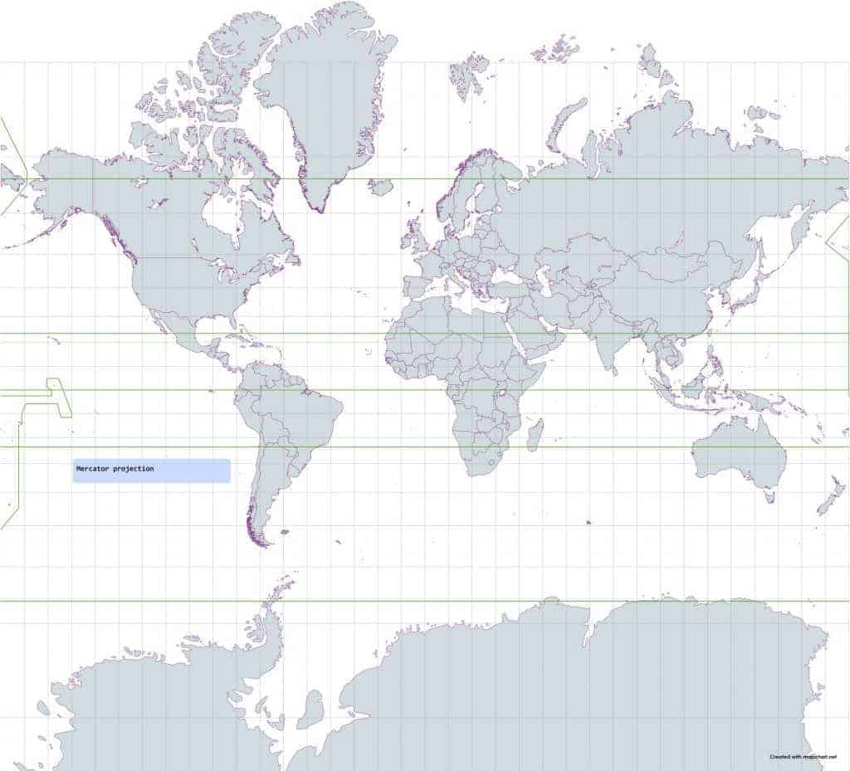
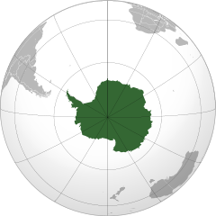
Projections.
All projections distort…

Slide 21
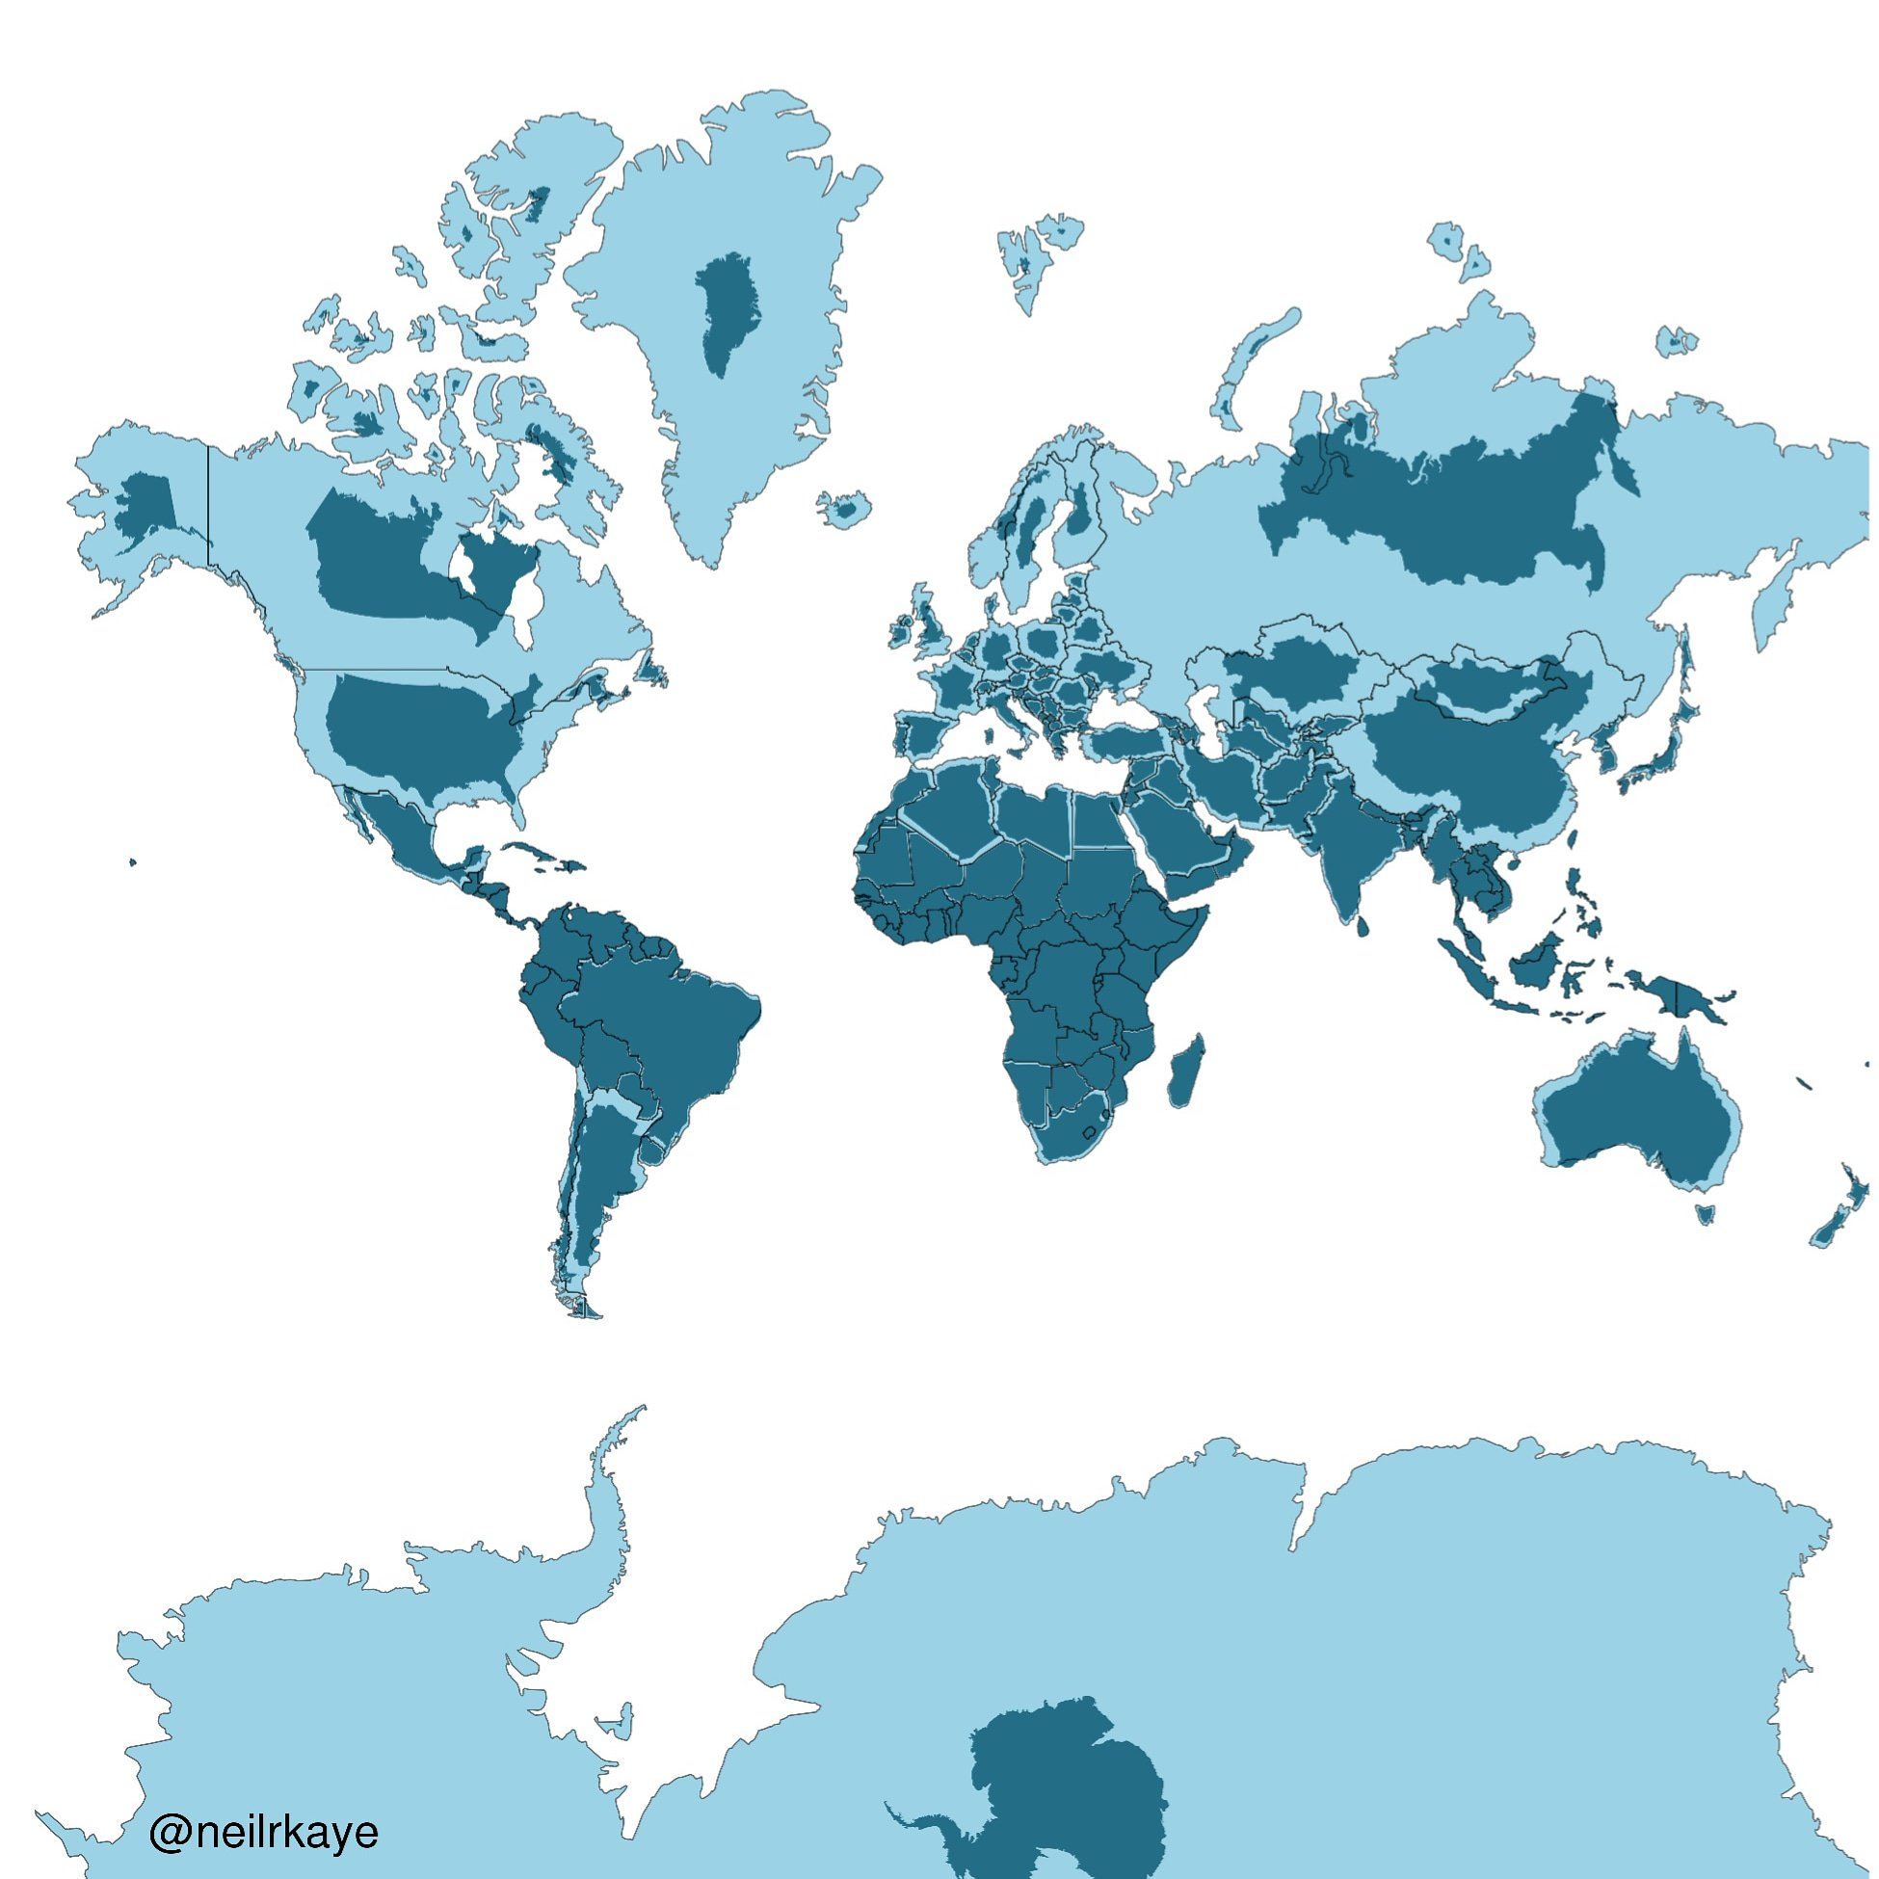
Projections.
Mercator projection, with true shape overlaid.
https://twitter.com/neilrkaye

Slide 22
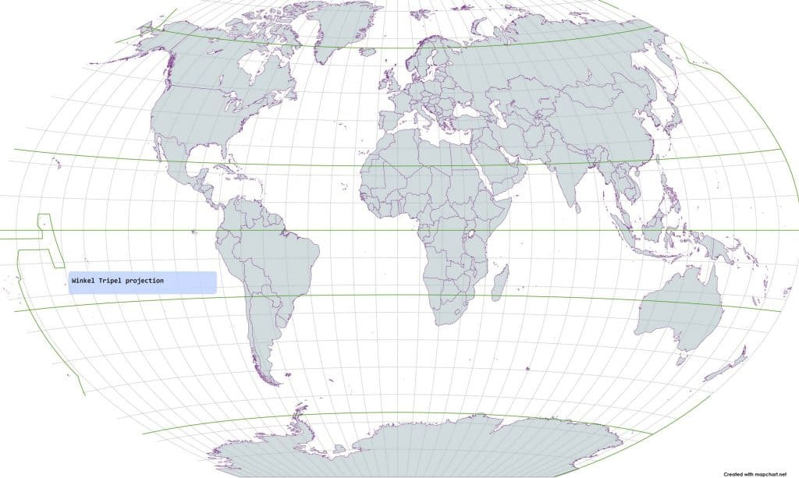
Projections.
Winkel Tripel projection
Used by National Geographic

Slide 23
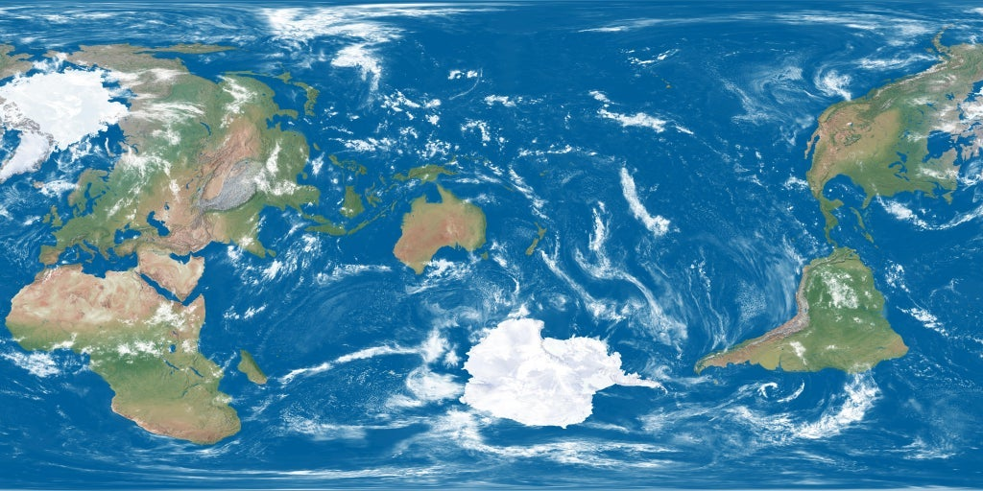
Projections.
Earth centred on NZ

Slide 24
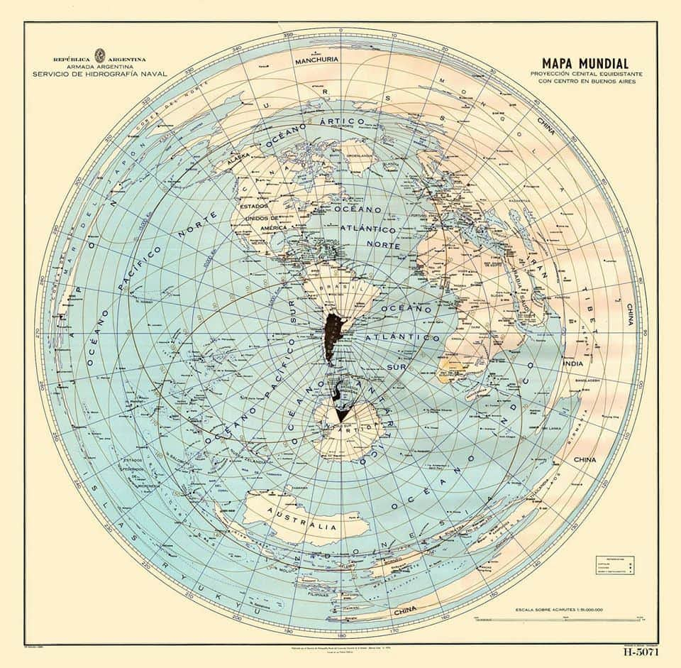
Projections.
World centred on Buenos Aires
Conclusions:
All projections distort
The larger the area, the greater the distortion at the edges in many projections.
Think about the analytical implications of your projection. How does it drive your story?

Slide 25
GeoJSON and TopoJSON
The data you need to draw your map
Based on the JSON format. {“key”: “value”} pairs
GeoJSON data in the form of arrays, [X, Y]. Sets of arrays can be used for:
Points
Lines
Polygons
TopoJSON data in the form of arcs. These are sequences of points.
Topo from topology, not from topography. [Not about mountains].
Arcs are only defined once, so storage much smaller.
Files more complicated, and not intuitive to read with human eye.
Not so good with user-collected points
Very good when regions line up next to one another, as in political/state maps.

Slide 26
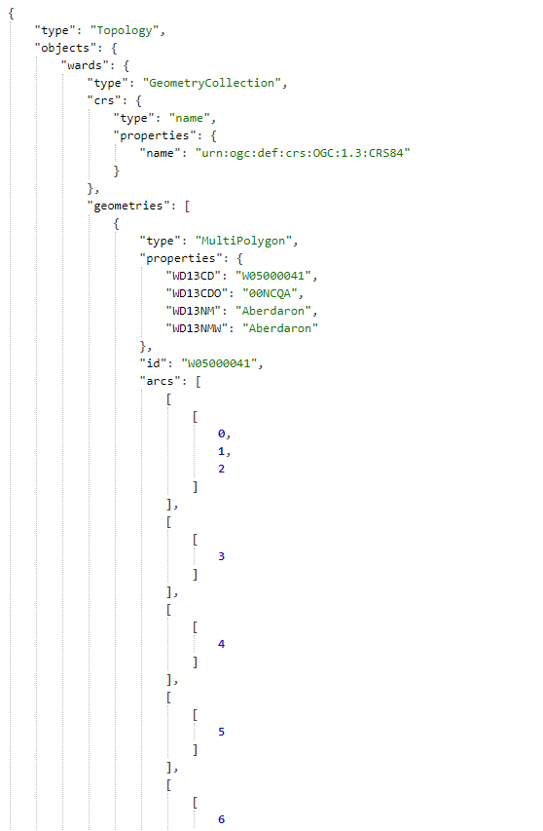
Base maps
Data sources
The base topoJSON files are open source:
US-Atlas. https://github.com/topojson/us-atlas
UK files. https://martinjc.github.io/UK-GeoJSON/

Slide 27
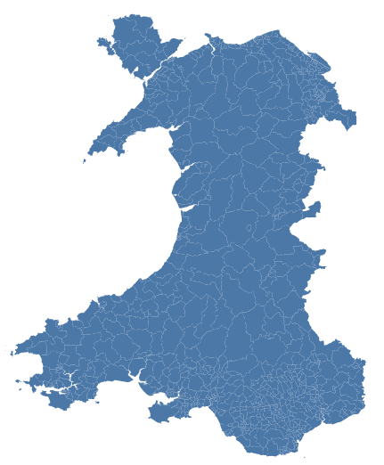
Simple example
Your first map
{"$schema": "https://vega.github.io/schema/vega-lite/v5.json",
"data": {
"url": "https://raw.githubusercontent.com/RDeconomist/RDeconomist.github.io/main/charts/maps/geoWalWards.json",
"format": {"type": "topojson",
"feature": "wards"}},
"projection": {"type": "mercator"},
"mark": {"type": "geoshape"}
}

Slide 28
Self-guided learning. Building tools to learn from the data
Introduction to Machine Learning
[90 min]
[30 min]

Slide 29
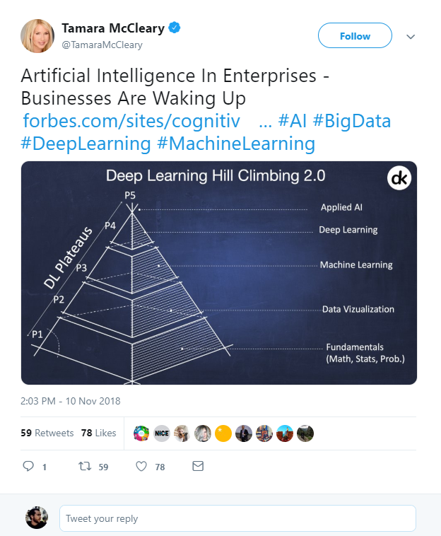

What is Data Science?
Artificial Intelligence?
Machine Learning?
Deep Learning?
Big Data?
https://twitter.com/TamaraMcCleary/status/1061197523610550272
Notes:
Tamara MCcleary – Tech Influencer
The data science pyramid
What do some of the more “fashionable” terms mean?
https://twitter.com/TamaraMcCleary/status/1061197523610550272

Slide 30

Data Science Handbook.
Jake VanderPlas.
UW | Google.
Introduction of Python.
Best introductory resource.
https://jakevdp.github.io/PythonDataScienceHandbook/
Notes:
http://vanderplas.com/
https://jakevdp.github.io/PythonDataScienceHandbook/
https://escience.washington.edu/people/jake-vanderplas/

Slide 31
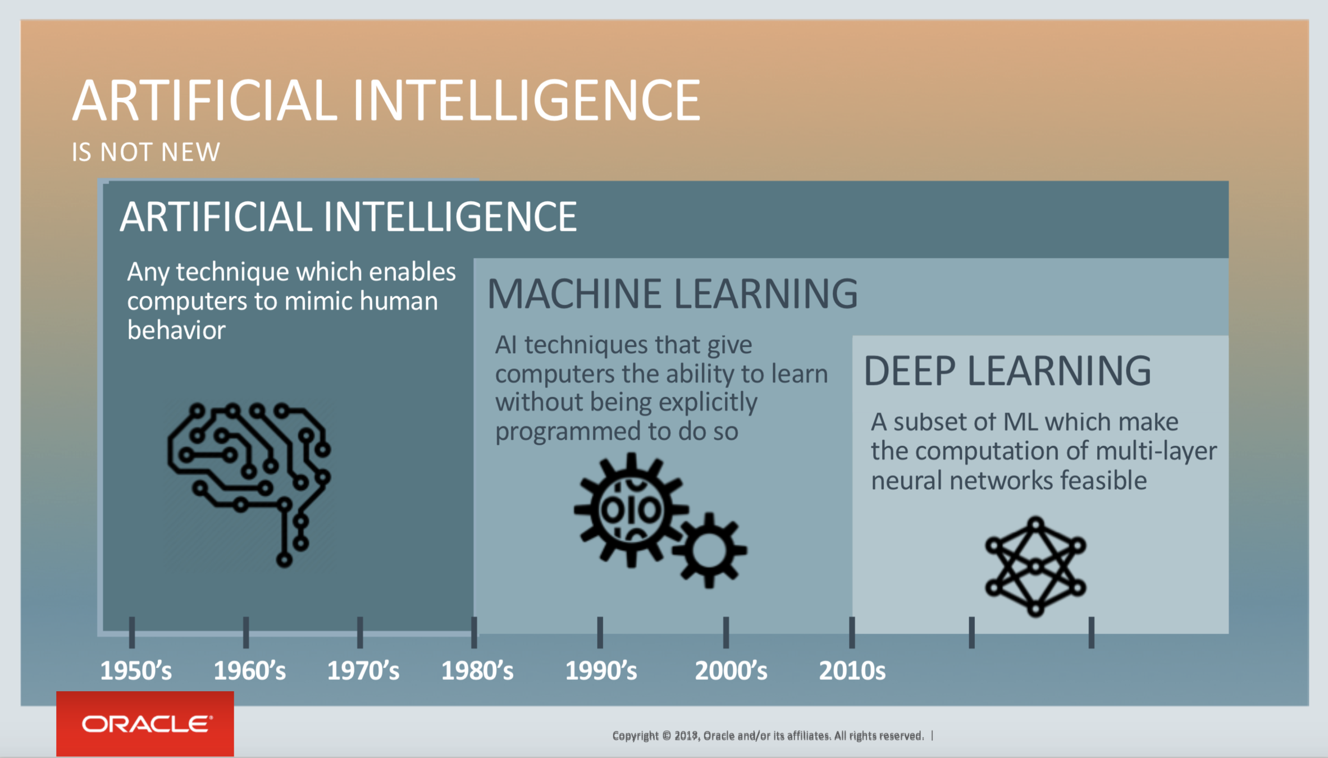
Notes:
https://blogs.oracle.com/bigdata/post/whatx27s-the-difference-between-ai-machine-learning-and-deep-learning

Slide 32


Slide 33
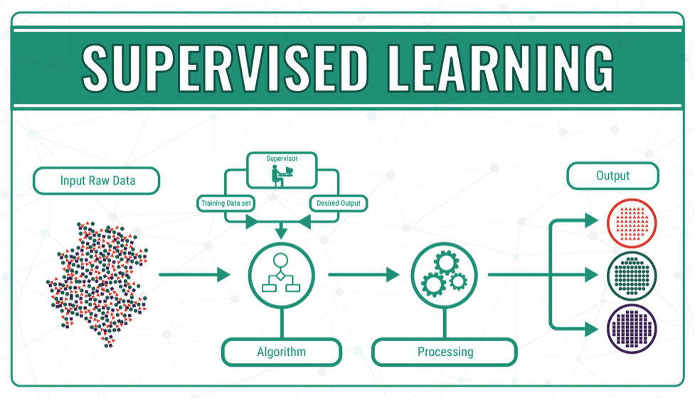
Notes:
https://bigdata-madesimple.com/machine-learning-explained-understanding-supervised-unsupervised-and-reinforcement-learning/

Slide 34
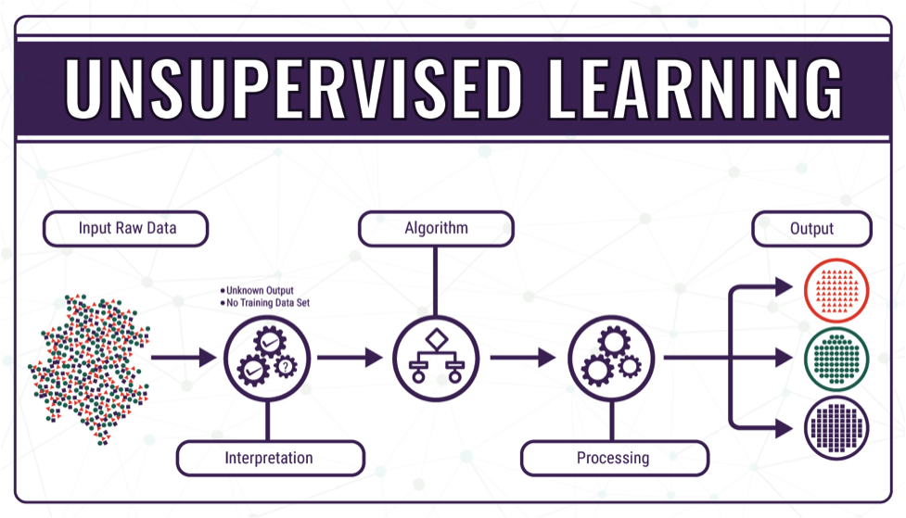
Notes:
https://bigdata-madesimple.com/machine-learning-explained-understanding-supervised-unsupervised-and-reinforcement-learning/

Slide 35

Notes:
https://bigdata-madesimple.com/machine-learning-explained-understanding-supervised-unsupervised-and-reinforcement-learning/

